Slide 1
PROJECT TITLE : Finance Receipting using Robotic Process Automation
PIP2001 Capstone Project
Review-0
Batch Number: CSD-G36
Under the Supervision of,
Dr. Chandrasekar Vadivelraju Professor, School of Computer Science and Engineering
Presidency University
STUDENT ROLL NO | STUDENT NAME
20211CSD0132 | KEREN ELISHEBA S
20211CSD0179 | VIKHYATH M B
20211CSD0168 | CHIRAG K SRINIVAS
Name of the Program: B.Tech Computer Science Engineering in Data Science
Name of the HoD: Prof. Saira Banu
Name of the Program Project Coordinator: Dr. Manjula H M
Name of the School Project Coordinators: Dr. Sampath A K / Dr. Abdul Khadar A / Mr. Md Ziaur Rahman

Slide 2
Content
Problem Statement
Analysis of Problem Statement
Timeline of the Project
References

Slide 3
Problem Statement Number:
Organization: KG Info Systems Pvt Ltd
Category (Hardware / Software / Both) : Software
Problem Description: A client needs to automate a back office process which has a volume of 25000 receipts per month. The information is structured, with pre-determined rules and conditions. The process has 10% of exceptions and also involves the use of paper. The source file is downloaded from SAP application, from which data is retrieved. Based on transaction type, client details are segregated as either Card or Cheque. Segregated user information is fed to the web application. For each Receipt number, templates are used to generate receipts and the same is mailed to the vendor specified in the source file. Each transaction type has its own template, which is available in the File Server. Design an automation solution which will automate the above process and email the receipts to corresponding vendor.
Difficulty Level: Complex

Slide 4
Analysis of Problem Statement
Technology Stack Components:
Robotic Process Automation (RPA).
SAP Integration.
Data Management & Storage.
Data Segregation and Rules Engine.
Document Generation (Template-Based).
Email Automation.
Exception Handling.
Optical Character Recognition (OCR) (for handling paper-based inputs).
Security & Compliance.
Reporting and Monitoring.
Collaboration & Version Control.

Slide 5
Analysis of Problem Statement (contd...)
Software Requirements
RPA Tools: UiPath, Automation Anywhere, Blue Prism (for RPA-based solutions).
Programming Tools: Python, JavaScript (for custom scripting).
IDE: Visual Studio Code, PyCharm (for development).
Database: SQLite, (for data storage).
Email Automation: Gmail/Outlook SMTP (for email sending).
Document Generation: Python-docx, Microsoft Word (for receipts/reports).
Web Automation: Selenium, Puppeteer (for web-based automation).
Cloud Platforms: Heroku, AWS Lambda (for deployment in the cloud).
Task Scheduling: Windows Task Scheduler, Cron Jobs (for scheduling).
Version Control: GitHub, GitLab (for collaboration).

Slide 6
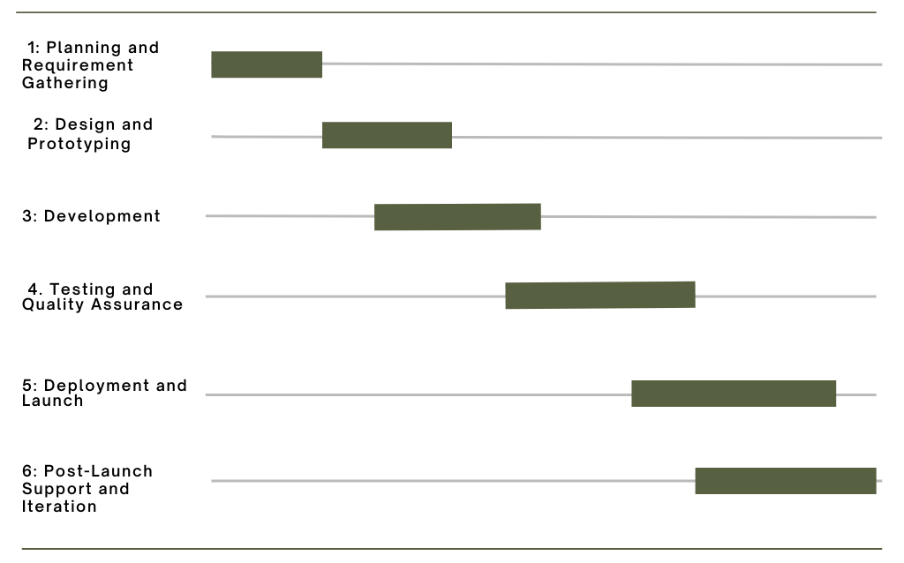
Timeline of the Project (Gantt Chart)

Slide 7
References (IEEE Paper format)
K. T. Wadsworth, M. T. Guido, J. F. Griffin and A. Mandil, "An innovation in paper receipts: the electronic receipt management system," 2010 IEEE Systems and Information Engineering Design Symposium, Charlottesville, VA, USA, 2010, pp. 88-93, doi: 10.1109/SIEDS.2010.5469674. keywords: {Technological innovation;Innovation management;Usability;Project management;Monitoring;User interfaces;Transaction databases;XML;Access protocols;Financial management}
Balamurugan, A & Vamsi, M & Bhattacharya, Rajib & Mohammed, Shariq & Kaushik, Priyanka & Haralayya, Dr. (2023). ROBOTIC PROCESS AUTOMATION (RPA) IN ACCOUNTING AND AUDITING OF BUSINESS AND FINANCIAL INFORMATION. Manager. 58. 127-142.
Costa, Diogo & S. Mamede, Henrique & Mira da Silva, Miguel. (2022). Robotic Process Automation (RPA) Adoption: A Systematic Literature Review. Engineering Management in Production and Services. 14. 1-12. 10.2478/emj-2022-0012.

Slide 8


